Slide 1

OHDSI STROKE
The relationship between stroke and aphasia survivors, mental health conditons, potentially inappropriate medicine and polypharmacy
Capstone Project Fall 2025
By Alex Rizvanov and Thang Nguyen

Slide 2
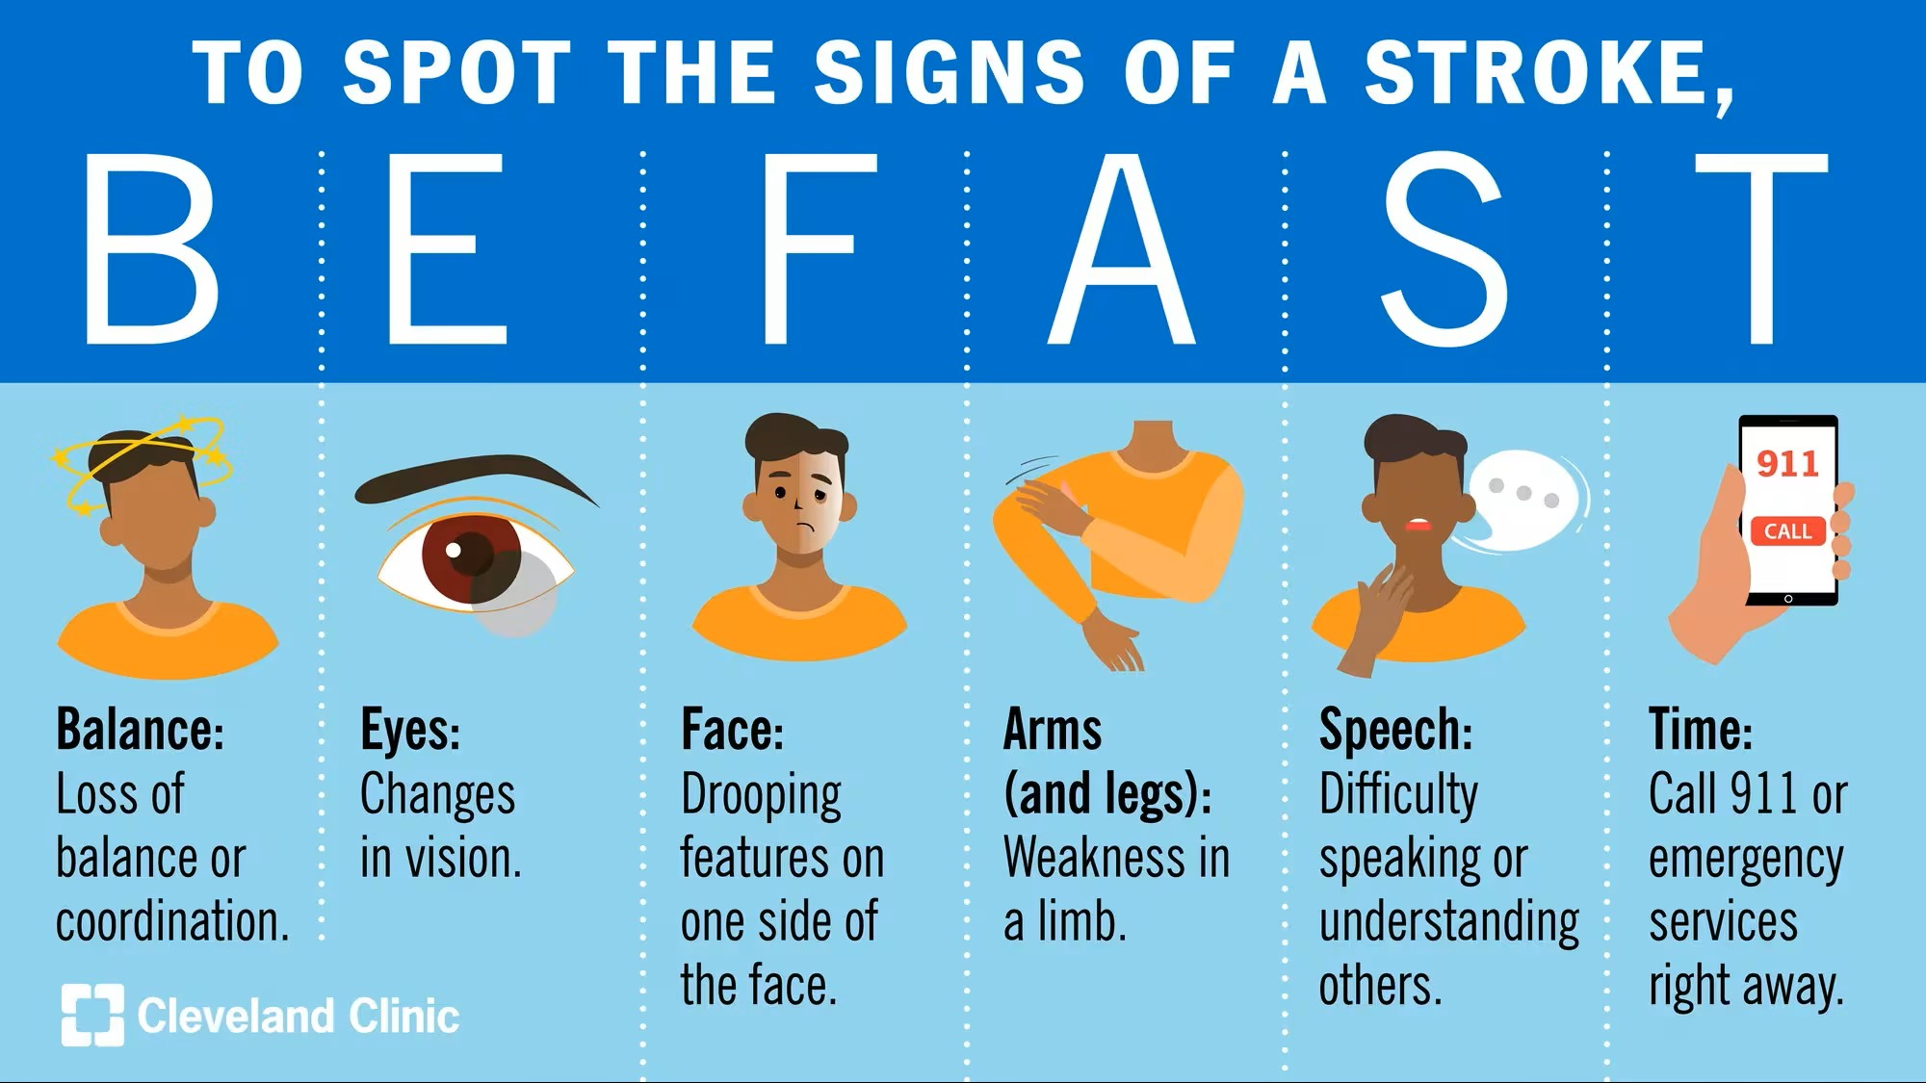
Introduction
A stroke is one of the most serious and costly health events in the United States
Among stroke survivors, up to 40 percent develop aphasia
These individuals typically undergo complex medical care involving multiple providers and medications, which increases the risk of polypharmacy and exposure to potentially inappropriate medications (PIMs)
Notes:
Occurring every 40 seconds and often leading to long-term disability that affects both quality of life and independence
Aphasia is a language impairment that makes it difficult to speak, understand, read, or write, creating significant communication barriers with healthcare providers
(PIMs), such as sedatives, anticholinergics, and antipsychotics that may negatively impact stroke recovery and cognitive function. Because mental health conditions are frequently underdiagnosed in patients with aphasia, inappropriate prescribing may be even more prevalent in this population.

Slide 3
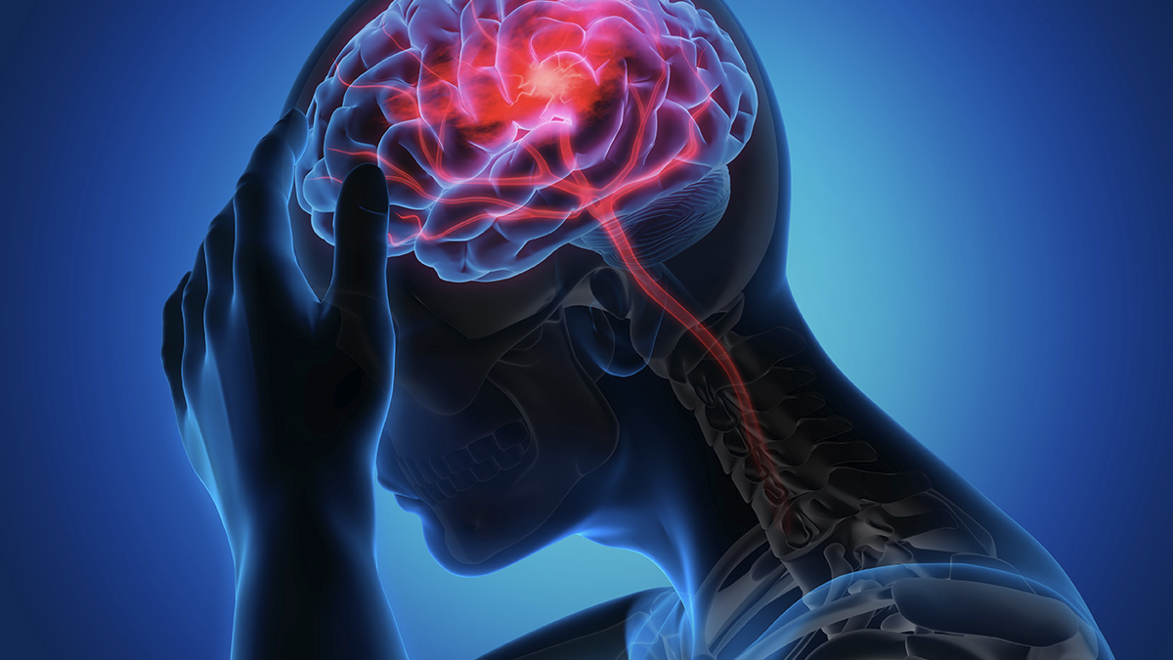
Goal
This project aims to examine the prevalence of potentially inappropriate medicine (PIMs) in stroke survivors with aphasia.
To achieve our aims, we need to quantify PIMs related to mental health conditions and stroke recovery.
Lastly, we will investigate whether these medication patterns are associated with increased 30- or 90-day hospital readmissions, highlighting the need for safer and more targeted prescribing practices for this vulnerable group

Slide 4

Data
The OHDSI (Observational Health Data Sciences and Informatics) dataset is a large-scale healthcare database that is standardized using the OMOP Common Data Model (CDM)
This project will use the OHDSI Lab Pharmetrics+ data at Northeastern
(https://ohdsi.github.io/CommonDataModel/cdm54.html)
Notes:
This project will use the OHDSI Lab Pharmetrics+ data at Northeastern. The Pharmetrics+ data era includes about 31 million patient-lives in a 5-year window, with 16 million individuals who have at least 1 year of continuous observation. The data are structured using the OMOP Common Data Model (https://ohdsi.github.io/CommonDataModel/cdm54.html), which is well documented but complex.

Slide 5
Stakeholder
Rob Cavanaugh, PhD, CCC-SLP, is an Assistant Professor at the Massachusetts General Hospital Institute for Health Professions and affiliate faculty at the Roux Institute
Feedback:
  Most of the feedback has generally been in helping us understand the project and data itself

Slide 6
Access and instruction
Need to gain OHDSI clearance after completing CITI training to access the data to run the code
Instruction and how to recreate the results in Github: https://github.com/ds5500/project-alex-riz-NE/tree/main

Slide 7
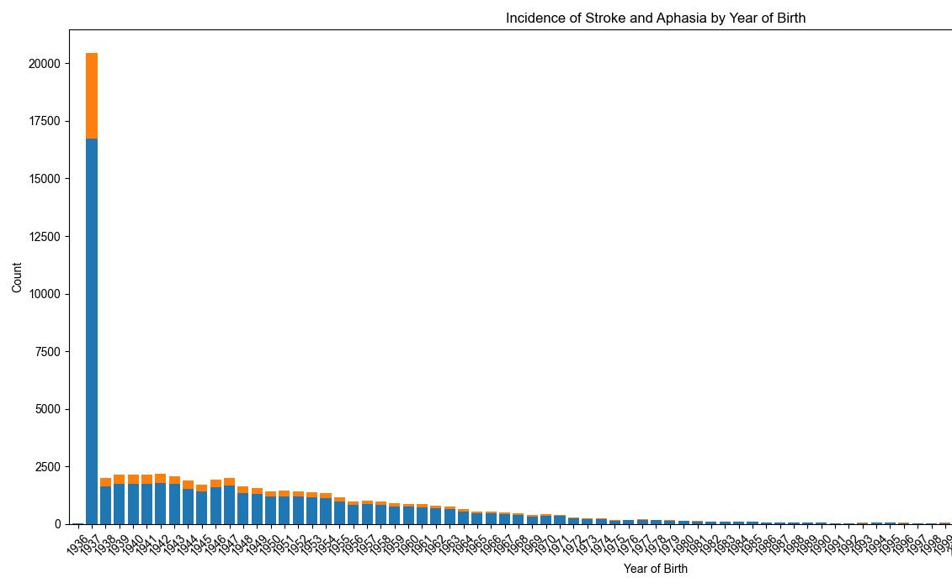
EDA
* Patients born before or during 1937 are all binned into one year.
Notes:
The risk of stroke increases as the populations ages, but there is clearly an outlier around the year 1937 when looking at the chart below. This is due to the fact that there are not enough of a population born before that year to hide the identity of the individuals to the standard that OHDSI holds. This leads to there not being a good way to dig insights based on granular age since there is a large mahority of the cohort who's age has been obfuscated. If age will be taken into consideration, then binning will be necesary.

Slide 8
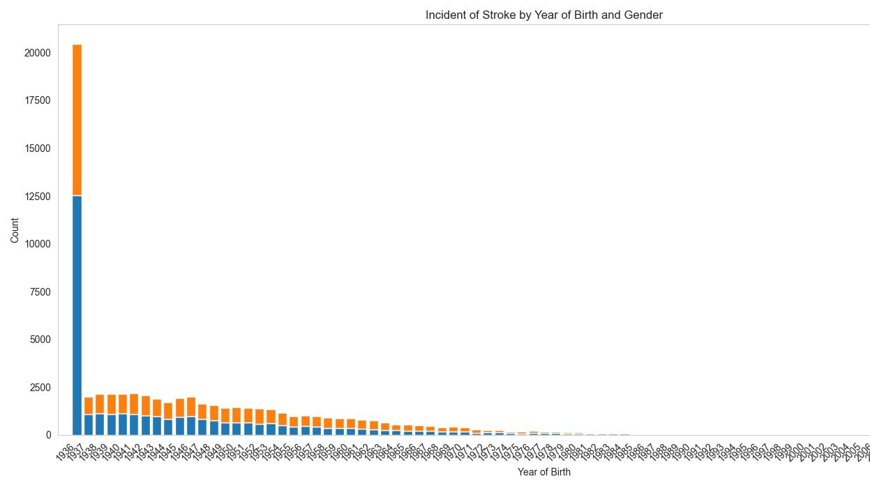
Notes:
When it comes to gender there is a pretty even mix of genders until age increases to some of the older patients where it started to lean heavily towards female.

Slide 9
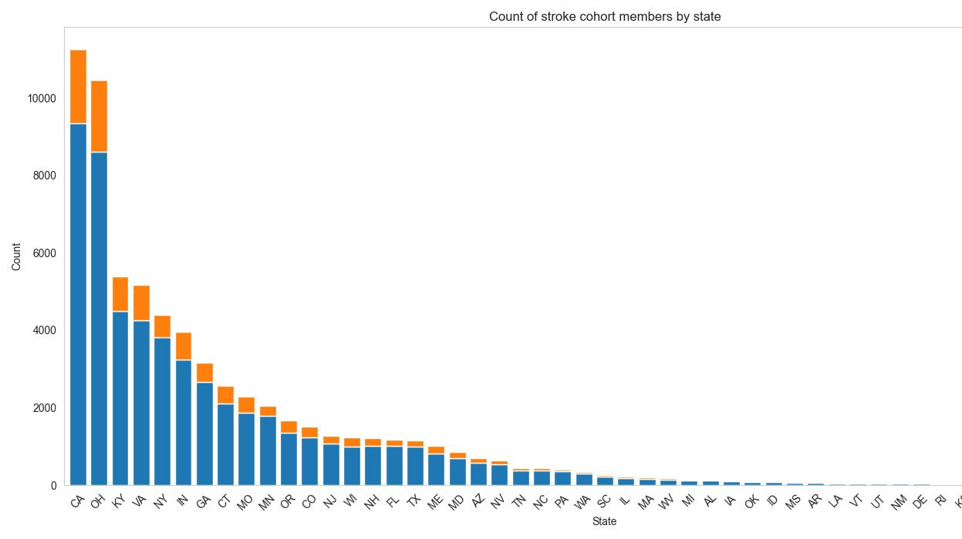
Notes:
The chart below shows that there is a wealth of data from some states while there is close to none in other. This could have many explinations. Some states might have greater healthcare coverage. Also, some states might have more access to care. Furthermore, some doctors might do a better job reporting and have closer ties to OHDSI and the data collection they did.

Slide 10
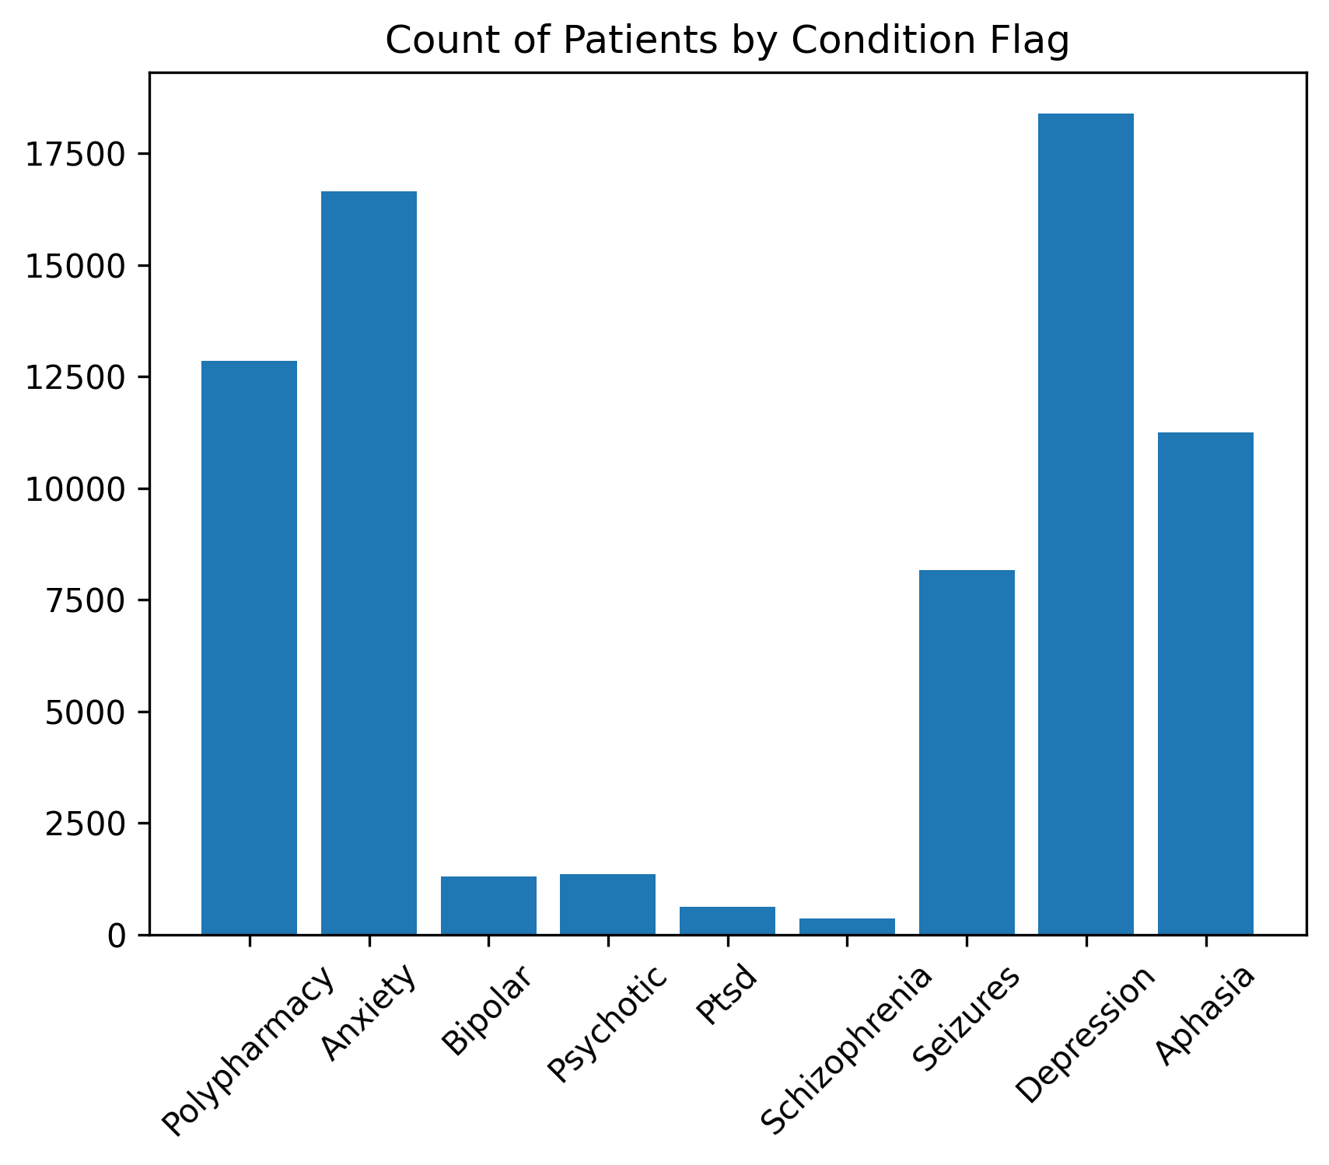
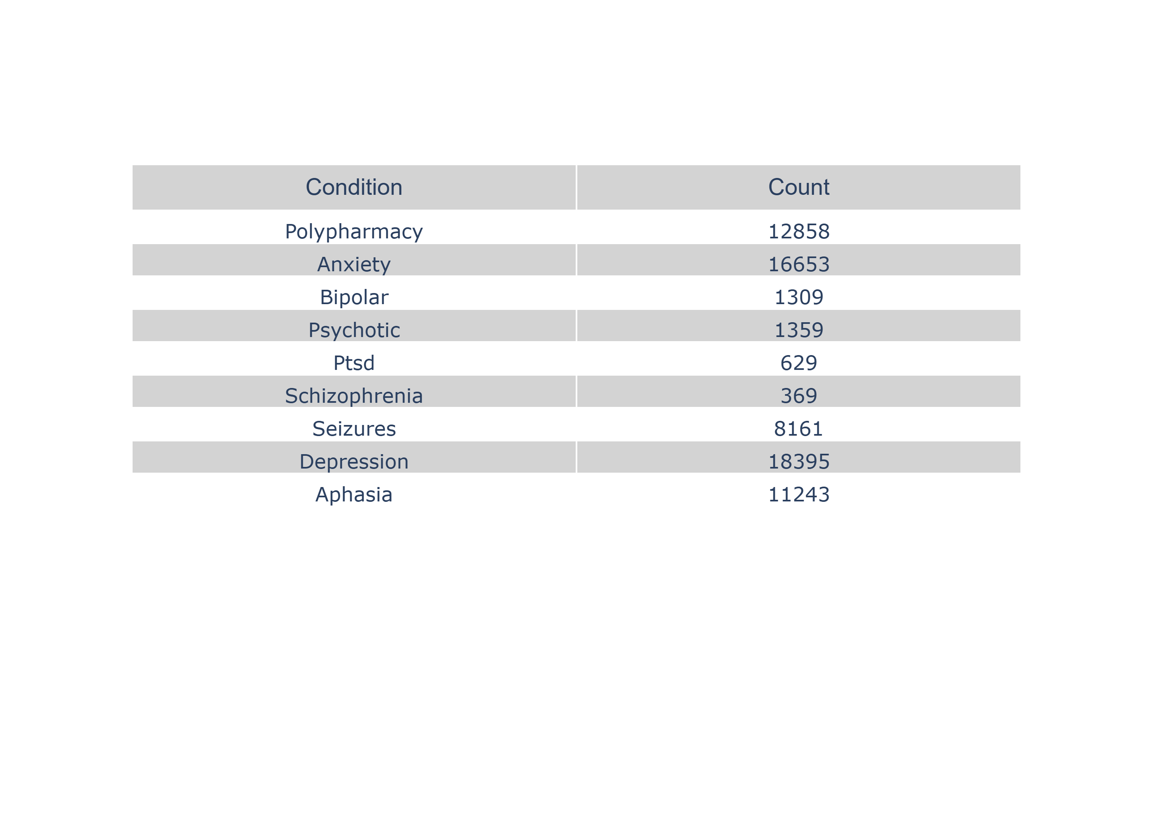
Cohort
Notes:
When looking at the raw data it seems like there are some conditions that are very rare for our cohort, that being bipolar, psychotic, ptsd, and schizophrenia. This makes sense since these conditions are rare in the population as well. The one shocking thing from this exploration was that there were a supprisingly high amount of the population who were flagged for polypharmacy, which is defined as having 5 or more substances in a 6 month timeframe before or after surgery.

Slide 11
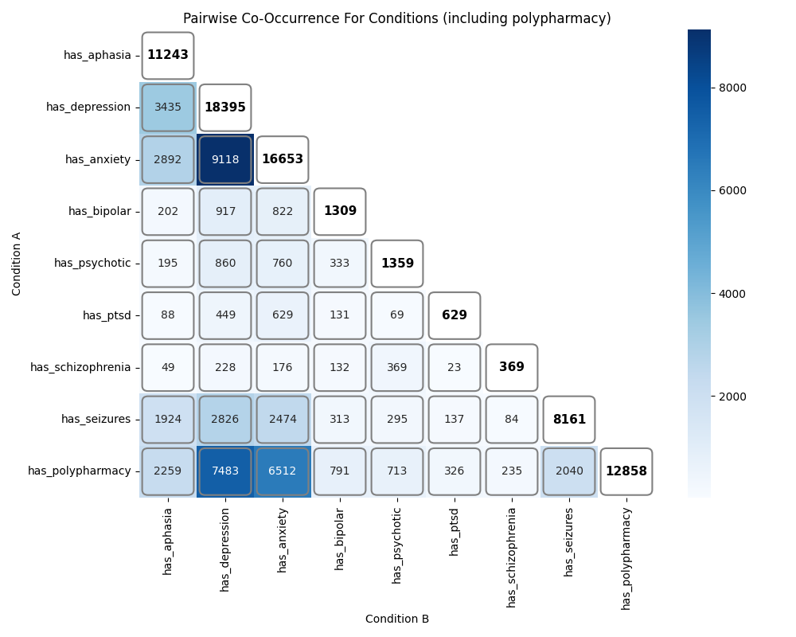
Co-occurence graph
Notes:
It is hard to compare nine different conditions to each other. The first step to try to get a bigger picture was to create a co-occurence graph. This graph sees how many times both flags were seen in the same person. As seen from the dark blue square: depression is commonly seen with polypharmacy as well as with anxiety, with 9118 and 7483 people in common. There are also a fair amount crossover between anxiety and aphasia which is interesting.

Slide 12
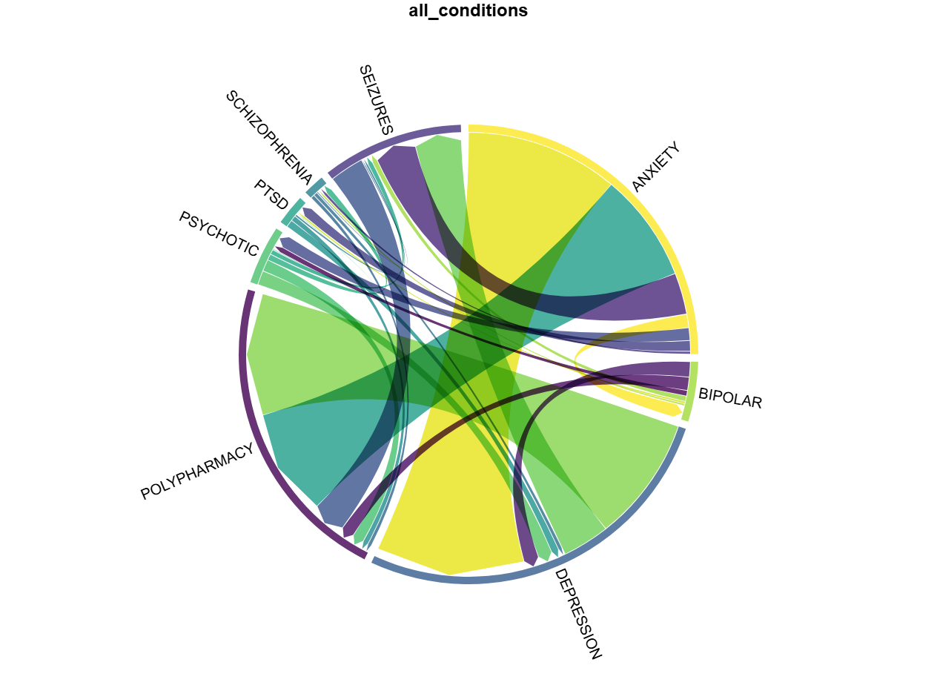
Notes:
The width of each segment, called a chord, represents strong relationships. The outer ring represents the proportion of the total as well as the start and target of each chord. It is hard to make out, but polypharmacy has chords connecting to all of the other conditions with its connection to anxiety and depression being the highest.

Slide 13
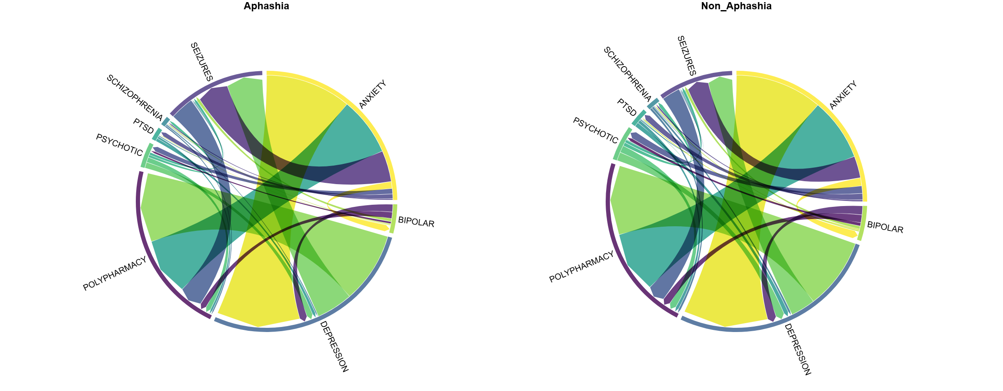
Notes:
The graph with aphasia appears to show that seizures have a stronger relationship to the other conditions, including polypharmacy. This makes sense due to there being more seizures with a population that has aphasia which would imply more medications.

Slide 14
Challenges
Patients born before or during 1937 are all binned into one year.
We lack a lot of Domain knowledge so there are some pauses in between meetings with Rob
  Along with this, there is not a lot of literature about PIMS outside of elderly patients
There are many moving parts to this project which leads to very long SQL queries and a lot of tables. Can be confusing.

Slide 15
Next Steps
Verify the data and methodologies we made for our condition and polypharmacy flags.
Start looking into hospital readmissions after 30 and 90 days after their stroke
Come up with a model to identify a subgroup with the highest risk of PIMs.

Slide 16
Thank you for listening

